Slide 1
Software architecture

Slide 2
Software Architecture & Design Introduction

Slide 3
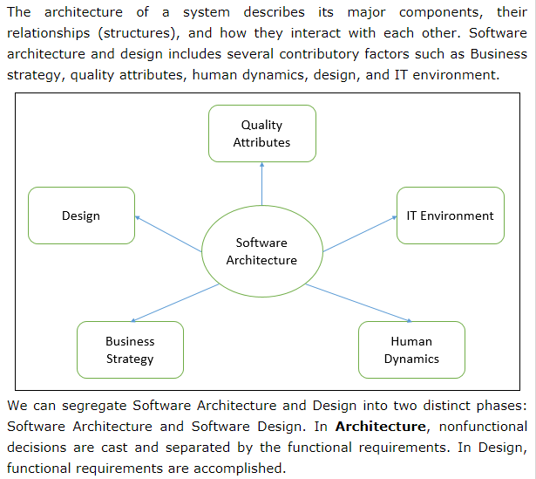

Slide 4
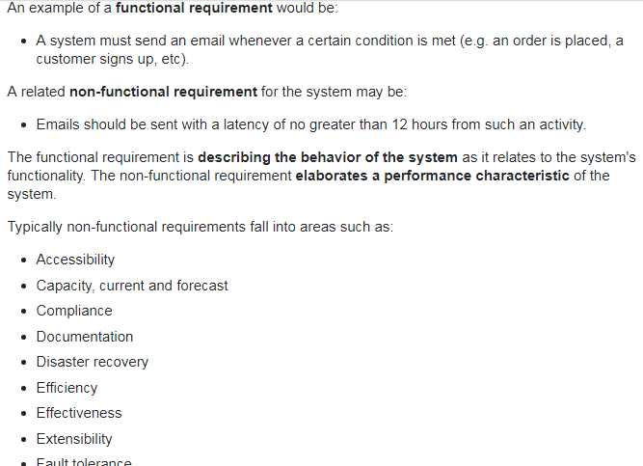

Slide 5
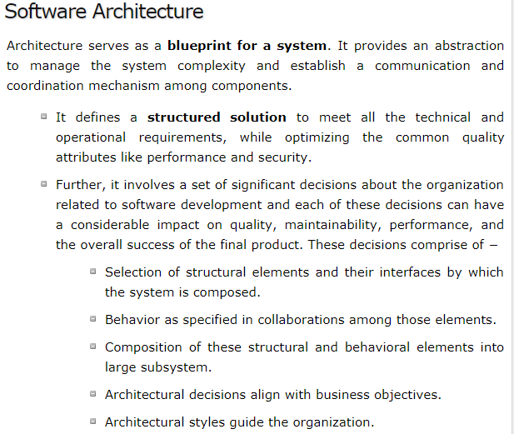

Slide 6
Software design

Slide 7
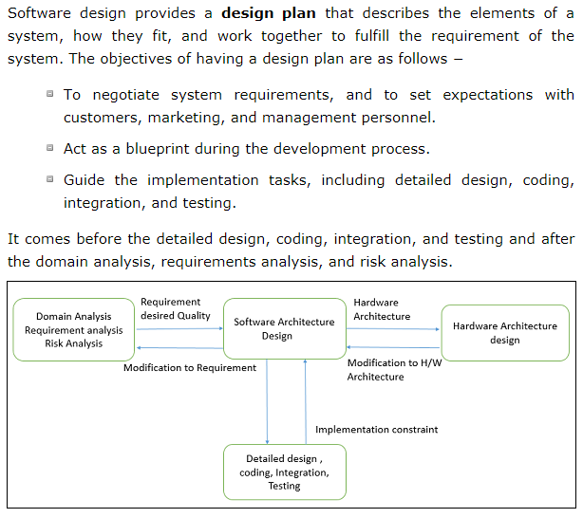

Slide 8
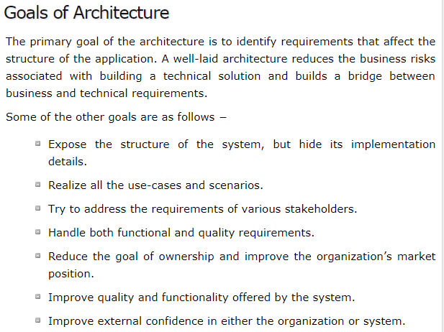

Slide 9
